Slide 1

Team Leader: Rewa Desale
Ministry/ Organization name : Student Innovation
Team Members:
Khushboo Chaudhari
Harshada Pawar
Ashwini Kulkarni
Nikita Harale
Arati Patil
Category : Smart Communication
Problem Statement No: IC464
Team Name : LYFsavers
Problem Statement : Emergency care for accidental person
College Name: Shri Vile Parle Kelavani Mandal’s Institute of Technology
Mentor: Mr. Bhushan Nandwalkar

Slide 2

Agenda
01
Introduction
02
Statistics and News
03
Problem Statement
04
Solution and Working
05
Summary
06
References

Slide 3
INTRODUCTION
All over India, there are the so many road accidents happens.
According to Report of 2017 of Ministry of Road Transport & Highways, 1.47 lakhs people died on Indian roads in 4.64 lakhs accident, Remaining injured people not get emergency care properly.

Slide 4
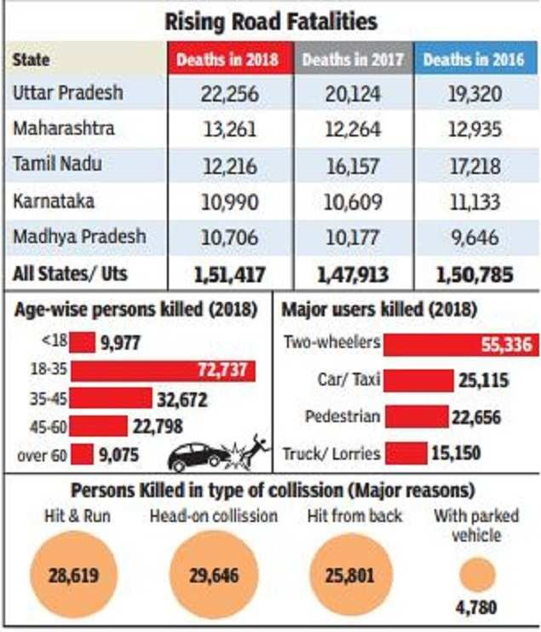
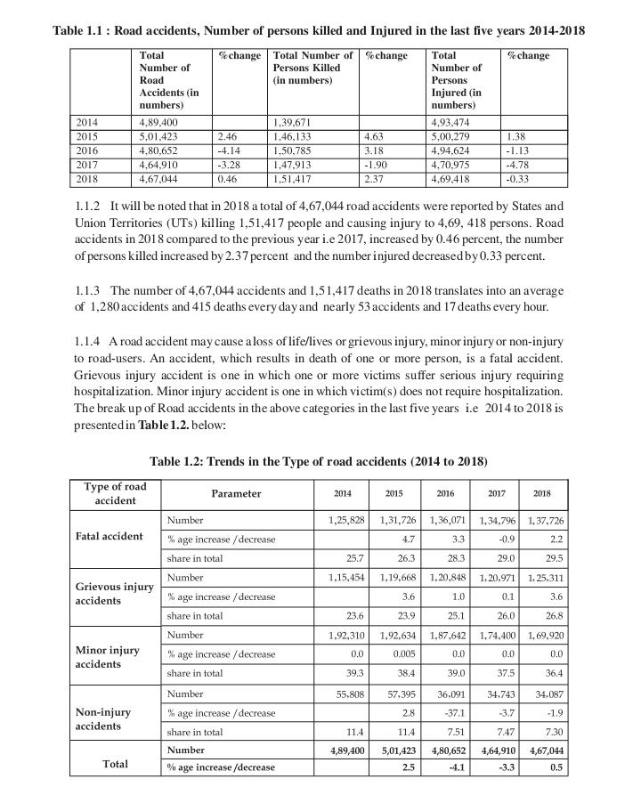
STATISTICS

Slide 5
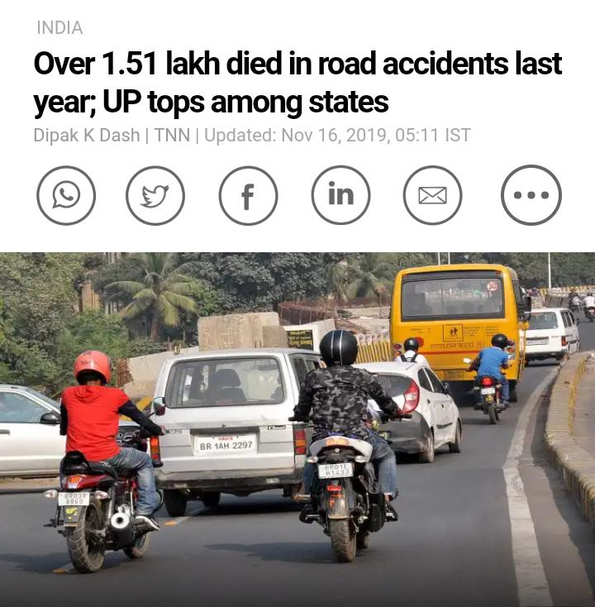
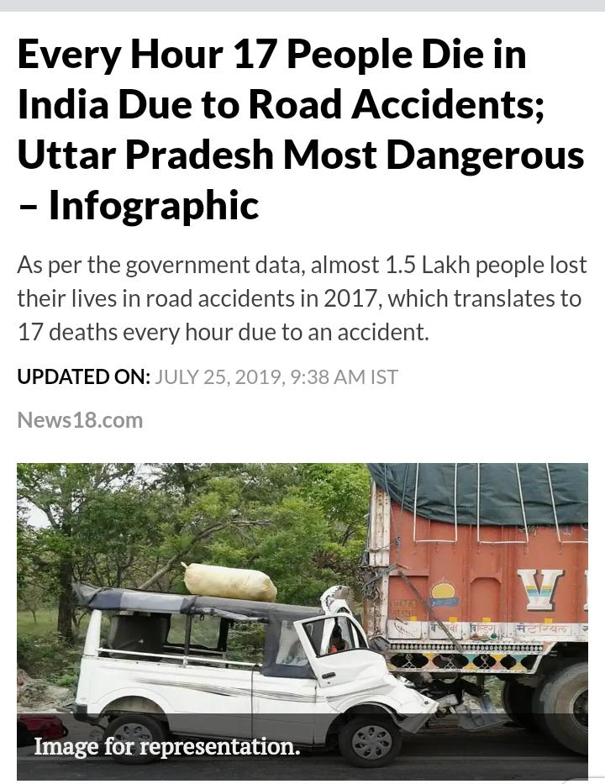
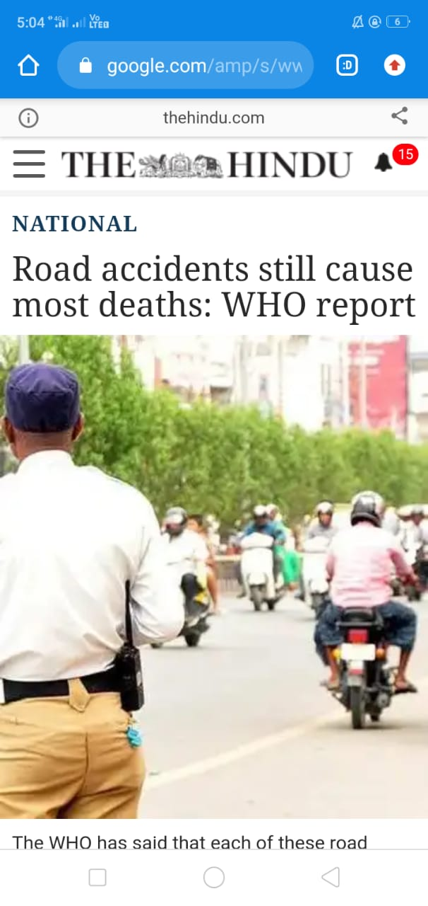
STATISTICS – NEWS

Slide 6
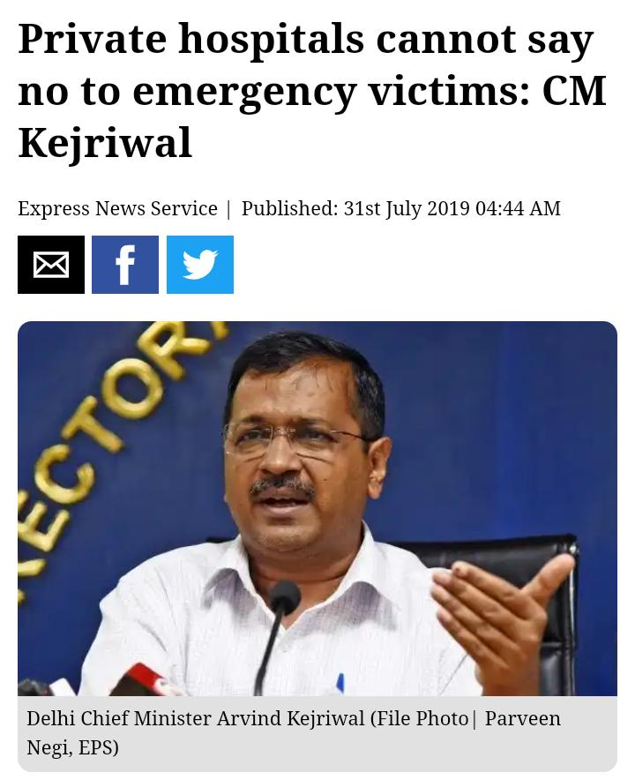
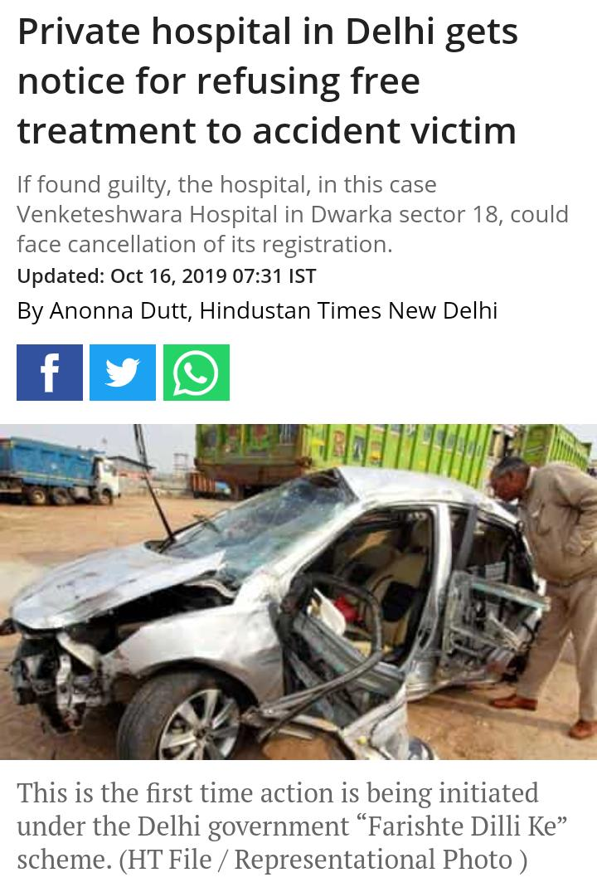
STATISTICS – NEWS
News – Hospitals NOT Accepting accidental Person

Slide 7
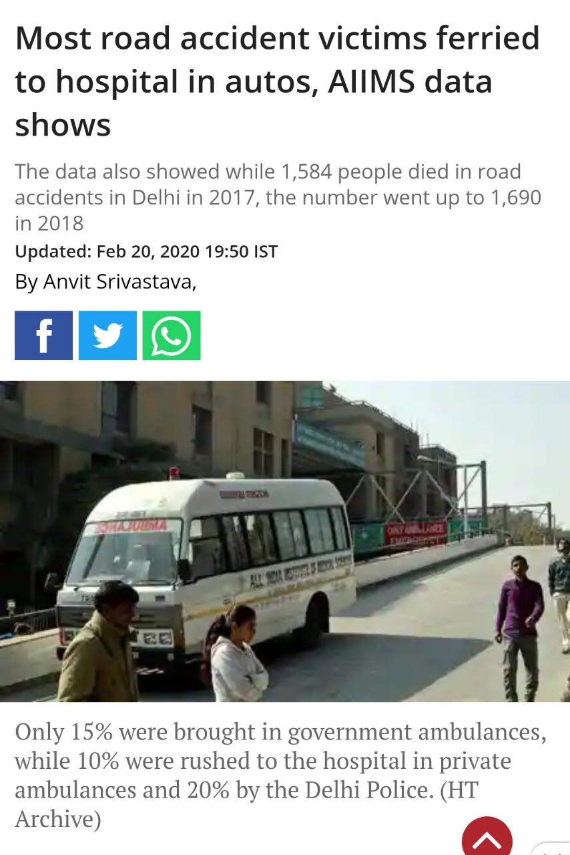
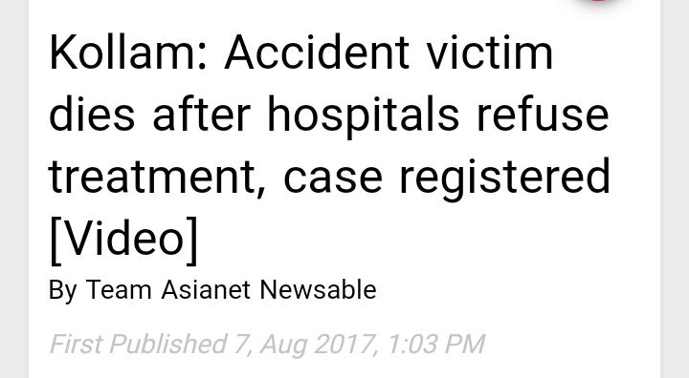
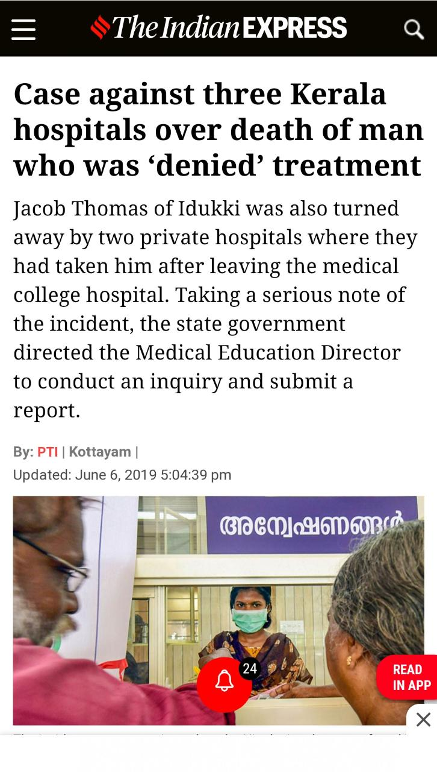
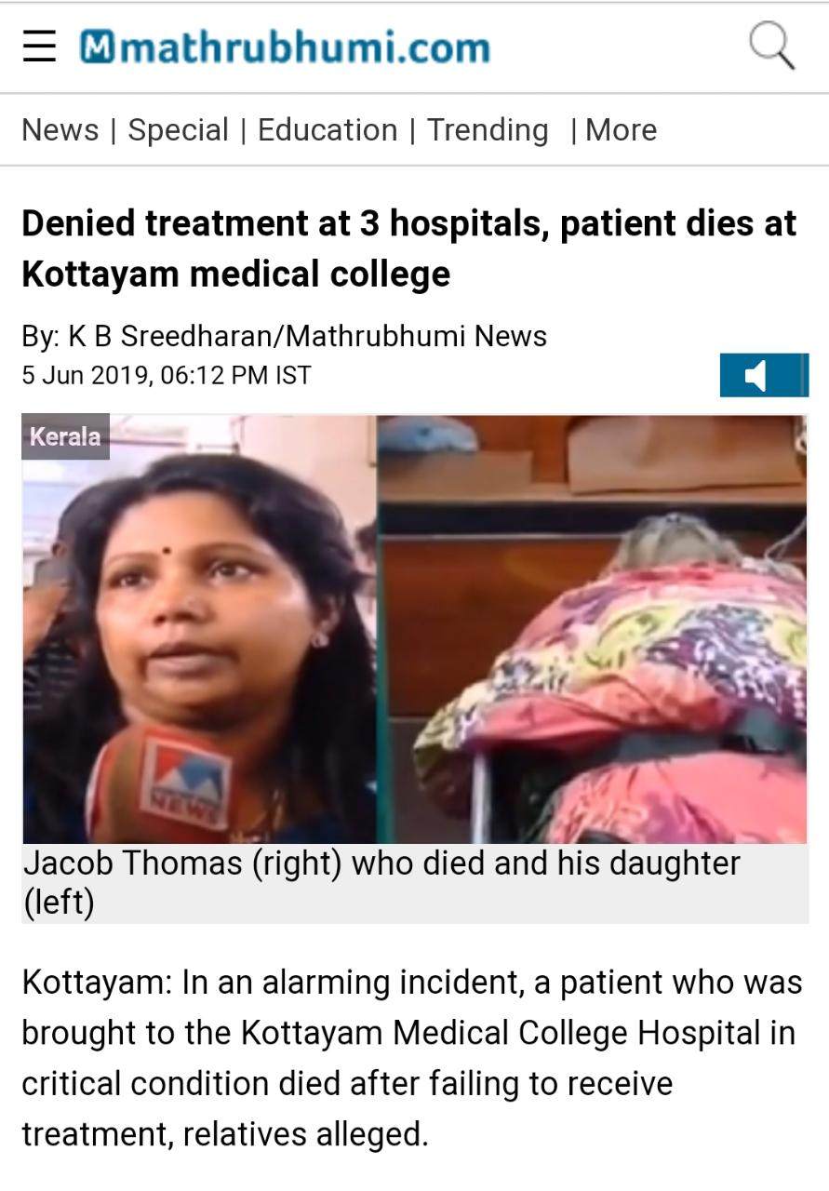
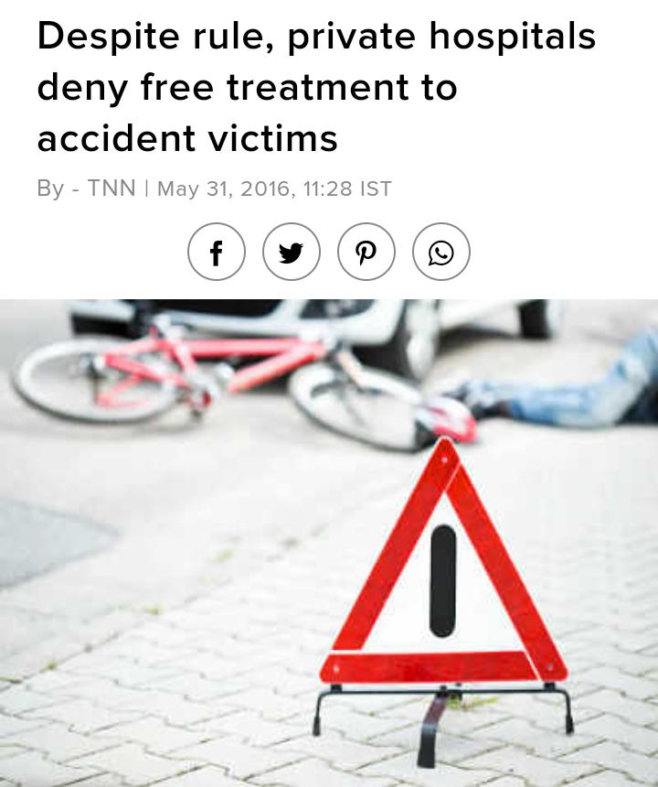
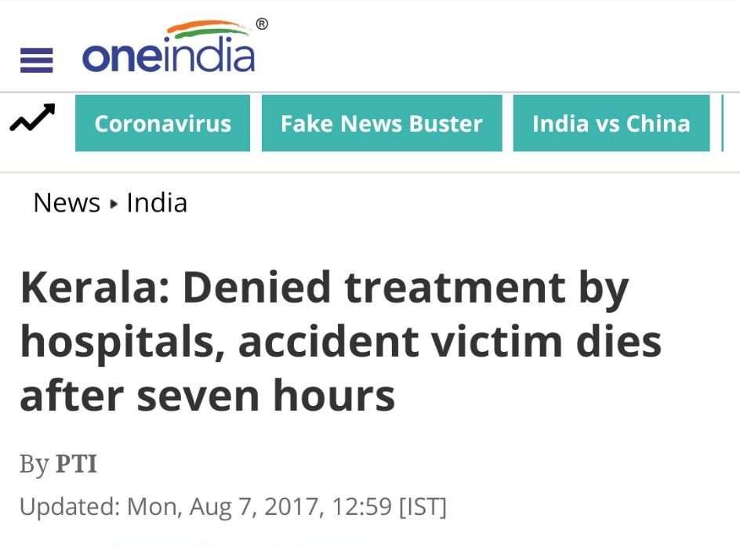
STATISTICS – NEWS
News – Hospitals NOT Accepting accidental Person

Slide 8
PROBLEM STATEMENT
What are the Problems?
Private Hospitals deny the victim
Ambulance takes victim to Government Hospital; Instead nearest Hospital
No notification is given while reaching to concern hospitals
No primary things are ready to get patient admitted like stretcher, vacancy in ICU if major accident

Slide 9
PROBLEM STATEMENT
Emergency Care for Accidental Person

Slide 10



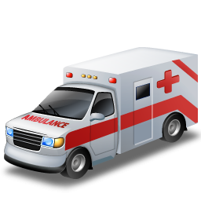
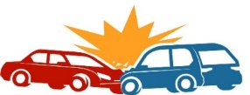

SOLUTION
2. Ambulance driver selects nearest hospital shown according to his location
3. Signal send to nearest hospital
1. Ambulance reached to accident place
3. Reporting to regional police station
Accident place

Slide 11
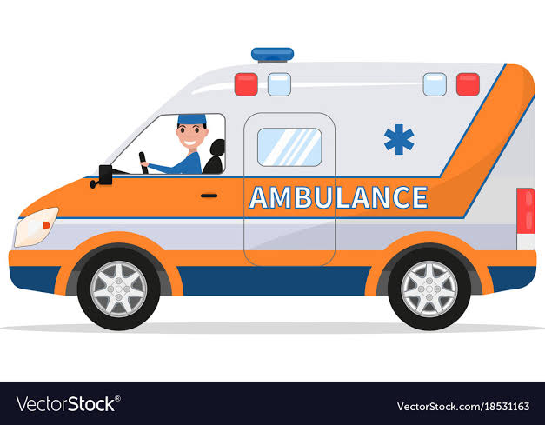

SOLUTION
In this system, 3 main actors
Admins in the system, to manage the system
Super Admin
Hospital Admin
Police Station Admin
Ambulance Admin
- NGO Admin
- NHAI Admin
Ambulance Driver
Hospital
Police Station

Slide 12


Hierarchy of the Admins in system
Super Admin
Super Admin
Ambulance Admin
Hospital Admin
Police Station Admin
NGO Admin
NHAI Admin
Ambulance Driver

Slide 13
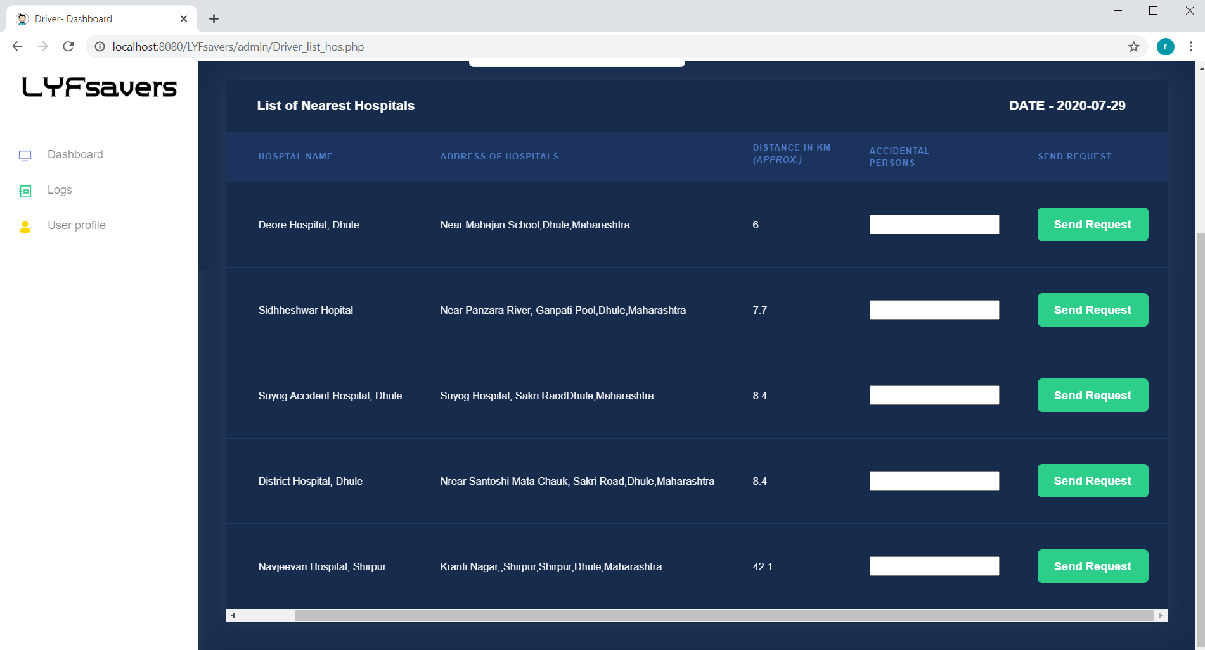
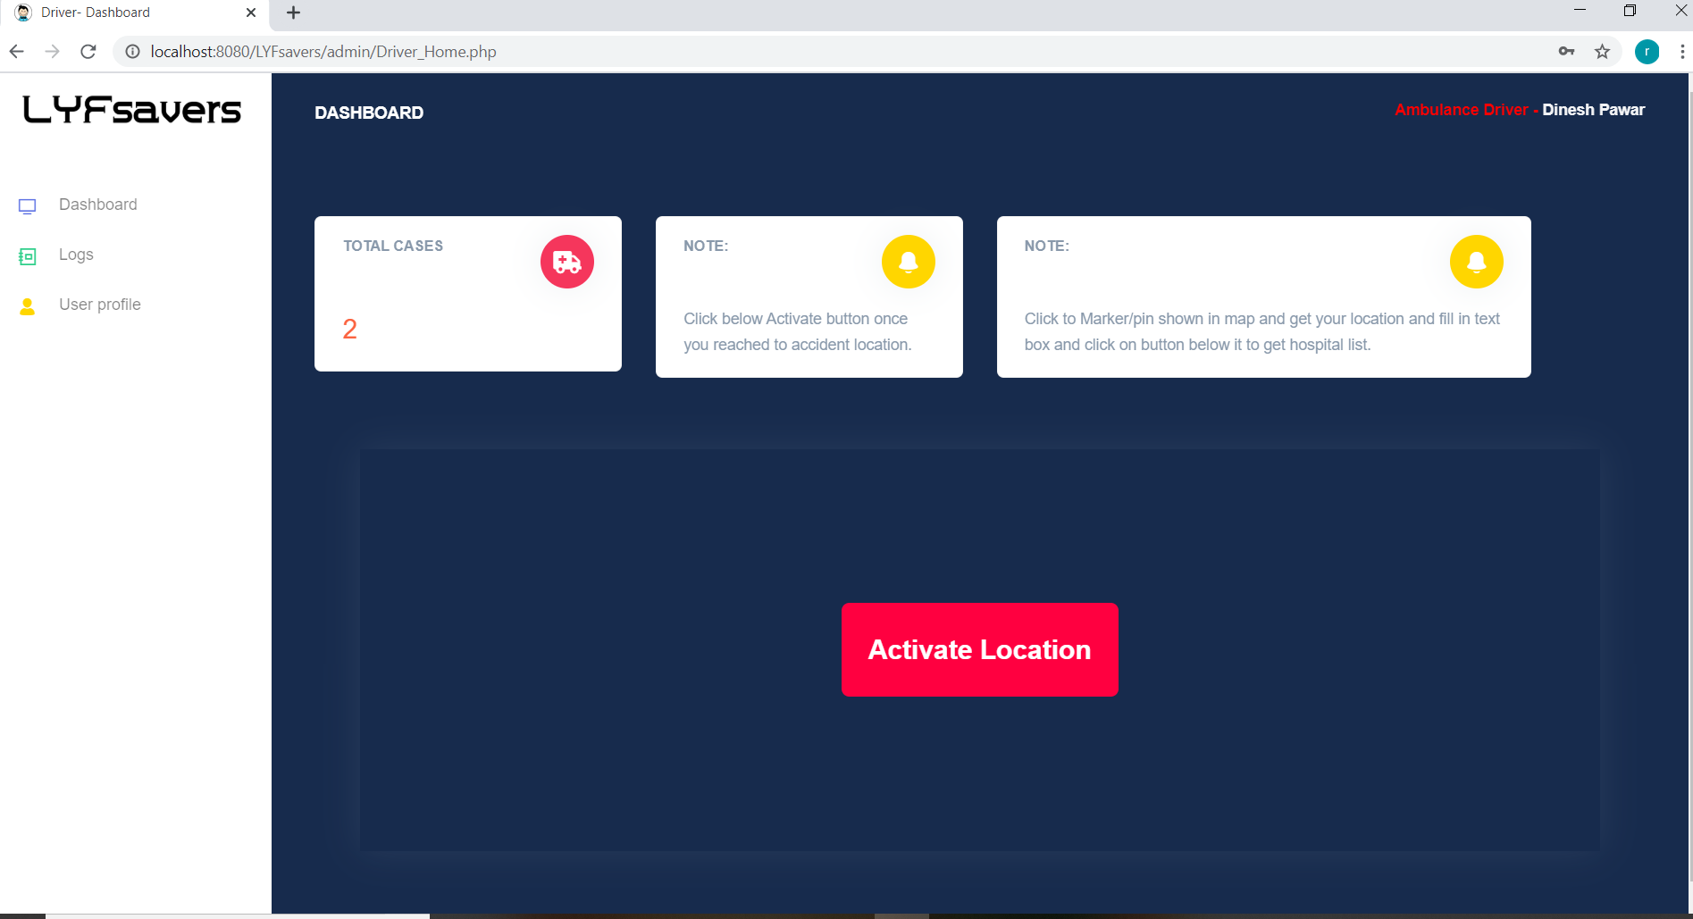
How Driver able to choose the Hospital ?

Slide 14
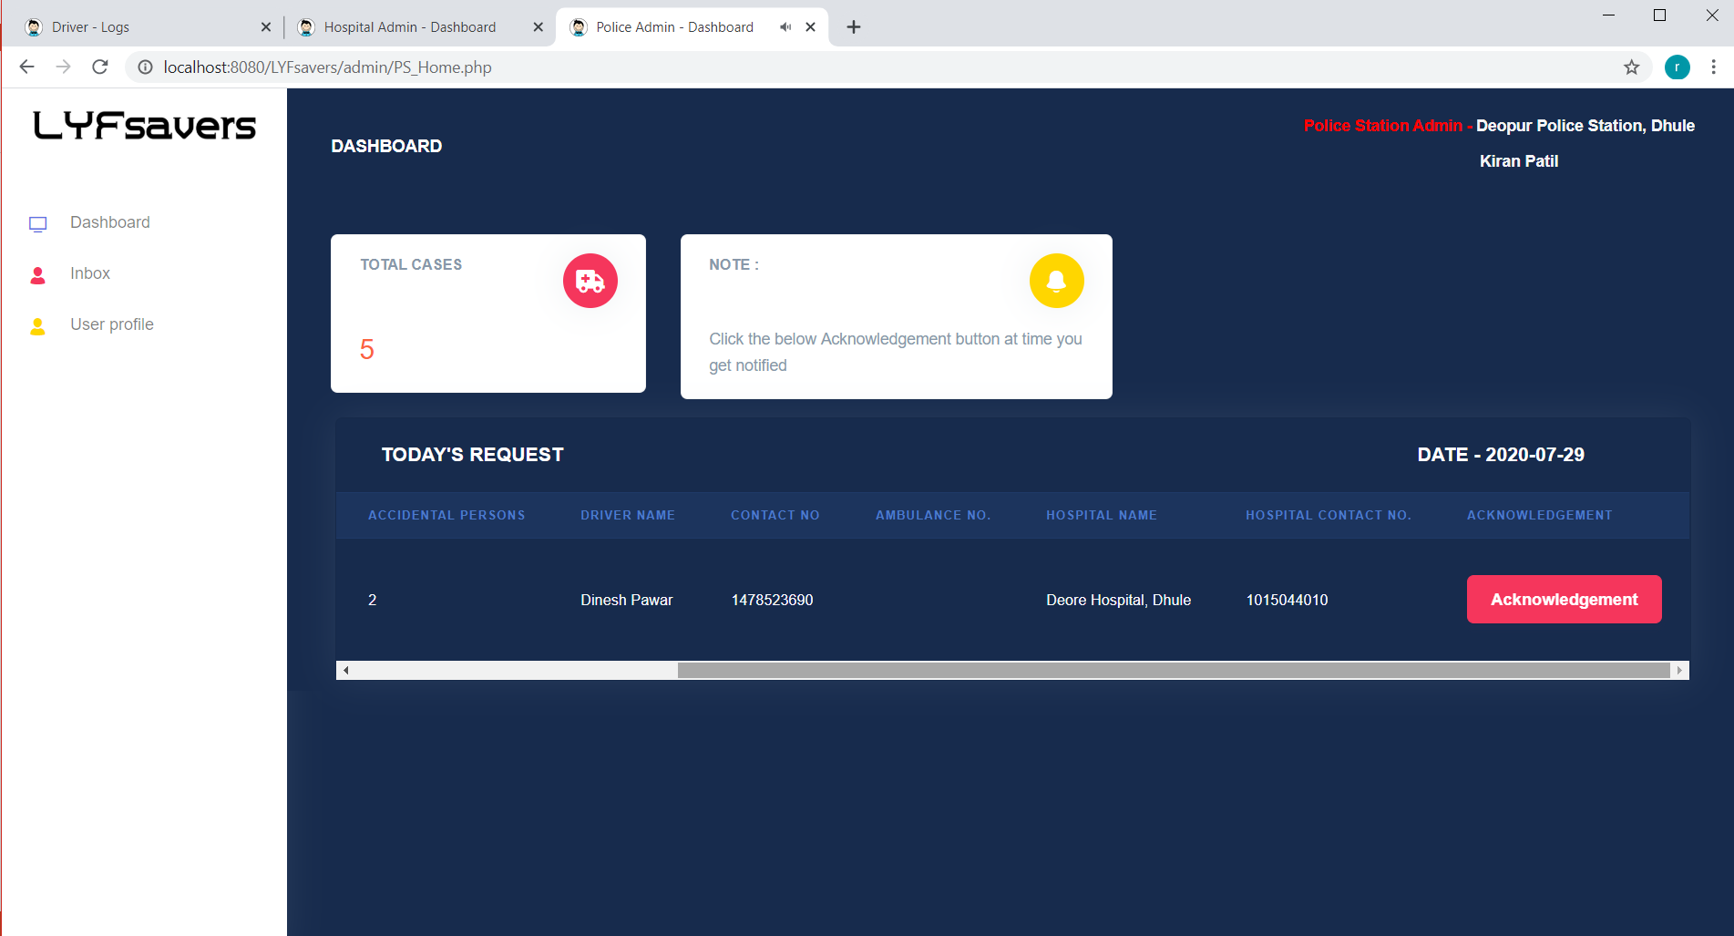
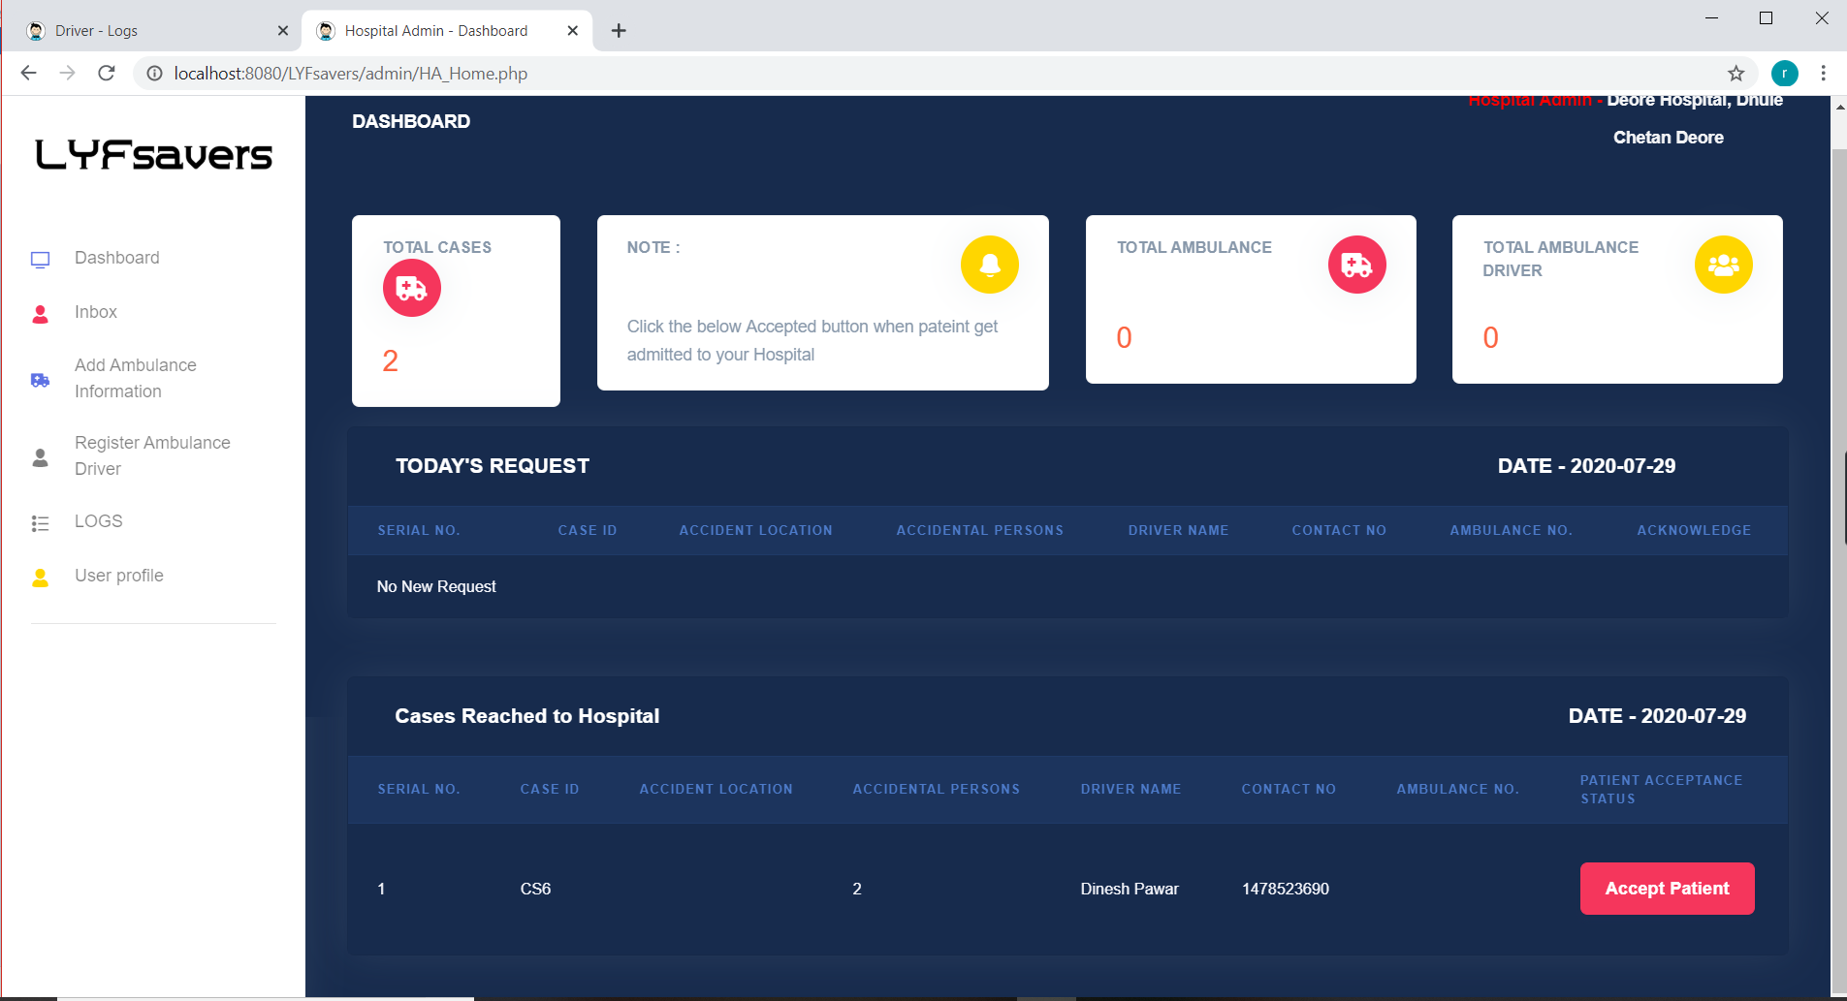
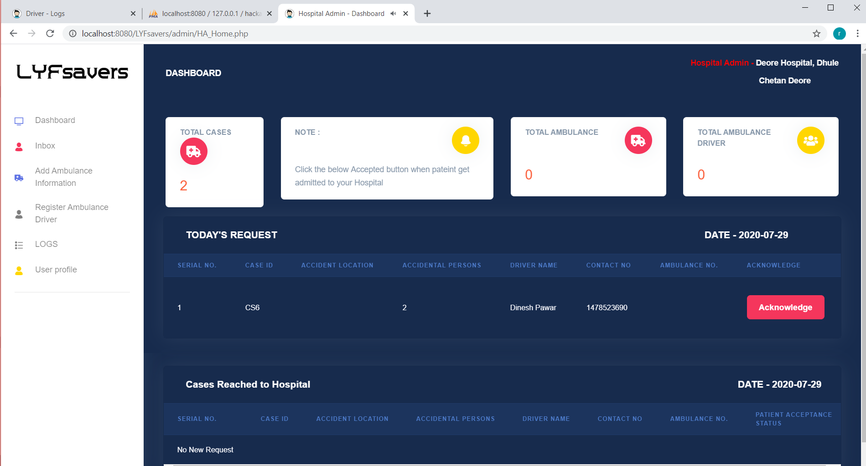
How Hospital and Police Station get Notified ?

Slide 15
SUMMARY
All hospitals get connected
Ambulance driver is able to see hospitals according to his location
Ambulance driver can send request to nearest hospital
Hospital and Police station get notified
All record get maintained digitally.
Management of system can be done smoothly because of hierarchical system
One life will be saved!

Slide 16
REFERENCES
Official Reports of Ministry of Road Tarsnaport and Highways
The Hindu NewsPaper
Times of India
The Indian Express
News18.com

Slide 17
THANK YOU..!!
- Team LYFsavers
We care for you!
.

